Slide 1
Using Connexus
Cousins Middle School
Summer 2020

Slide 2
You must start from the Cousins middle School Homepage
No matter what middle school you attend, start here!
Use the link on the menu labeled Connexus.

Slide 3
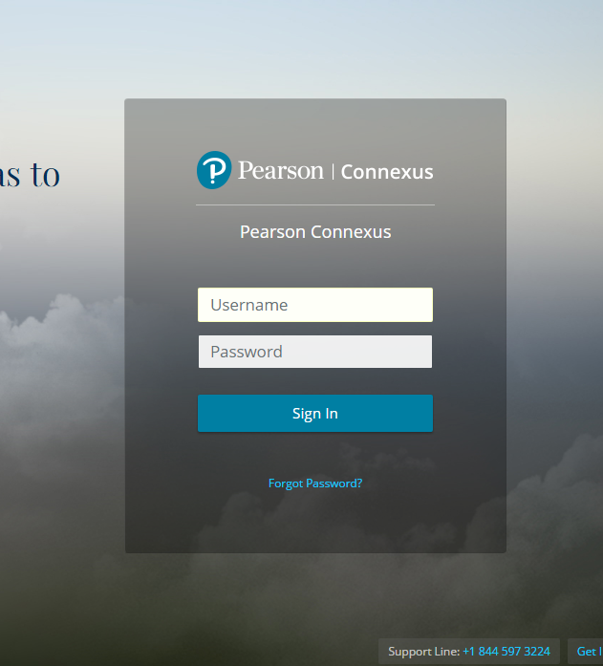
Next you will log in.
Your username is:
Lastnamefirstinitalstudentnumber
So
John Smith, lunch number 456789 will login like this:
smithj456789
Your password is Summerrec#1

Slide 4
Once you have logged in, you will see the course(s) that you are taking as a tile. Click on this tile.

Slide 5
Once you have clicked the course, you will see all your activities.
Each of these folders is a unit you will complete.

Slide 6
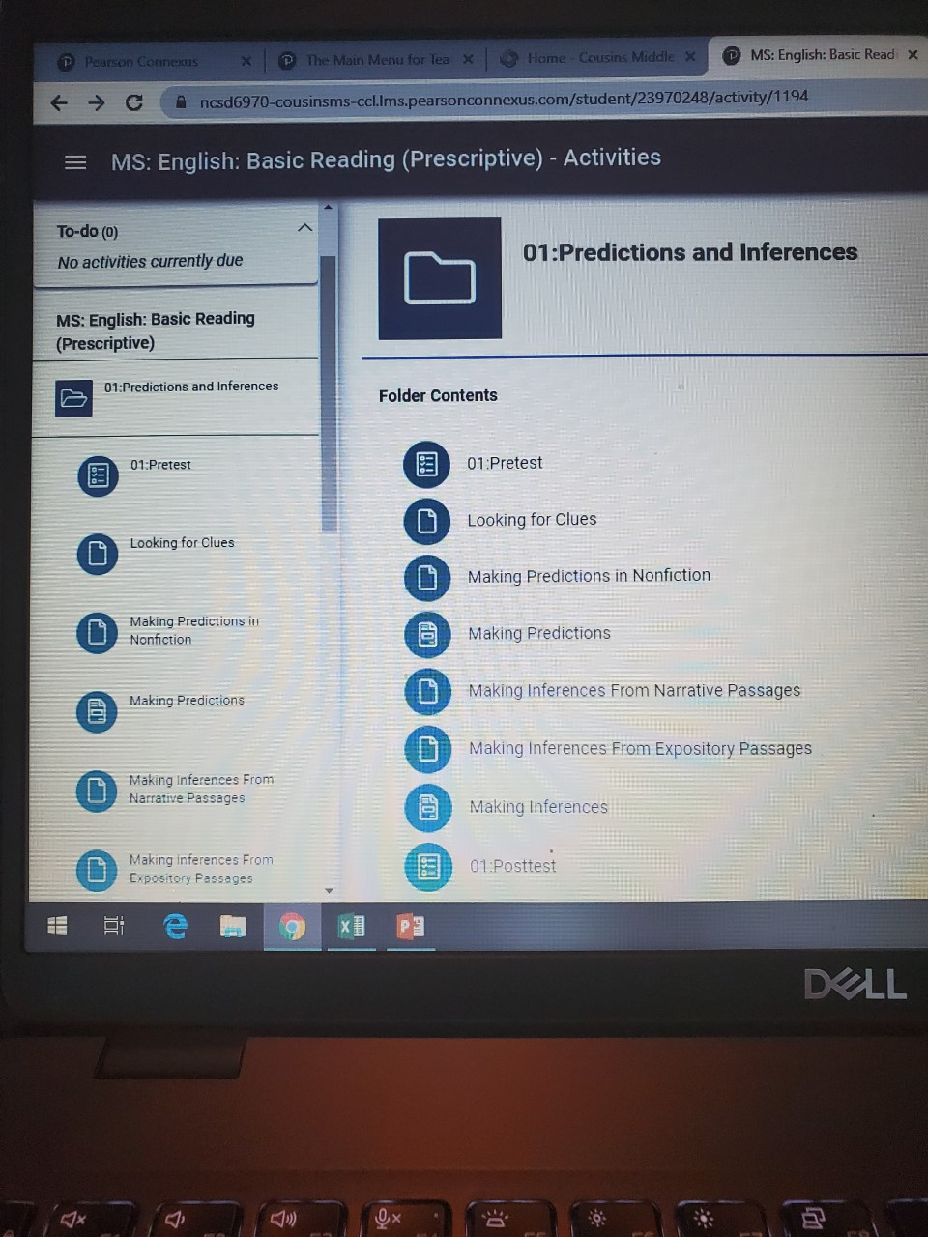
Start the unit by beginning with the first activity.
In this case, it is the pre-test.
Assignments with a blank sheet of paper, such as “Look for Clues” do not require an assignment from you.
Assignments with lines on the paper, such as “Making Predictions” will have an activity or quiz for you to complete.
You will end each unit with a post test.
You must score an 80 or above to move from lesson to lesson and unit to unit.

Slide 7
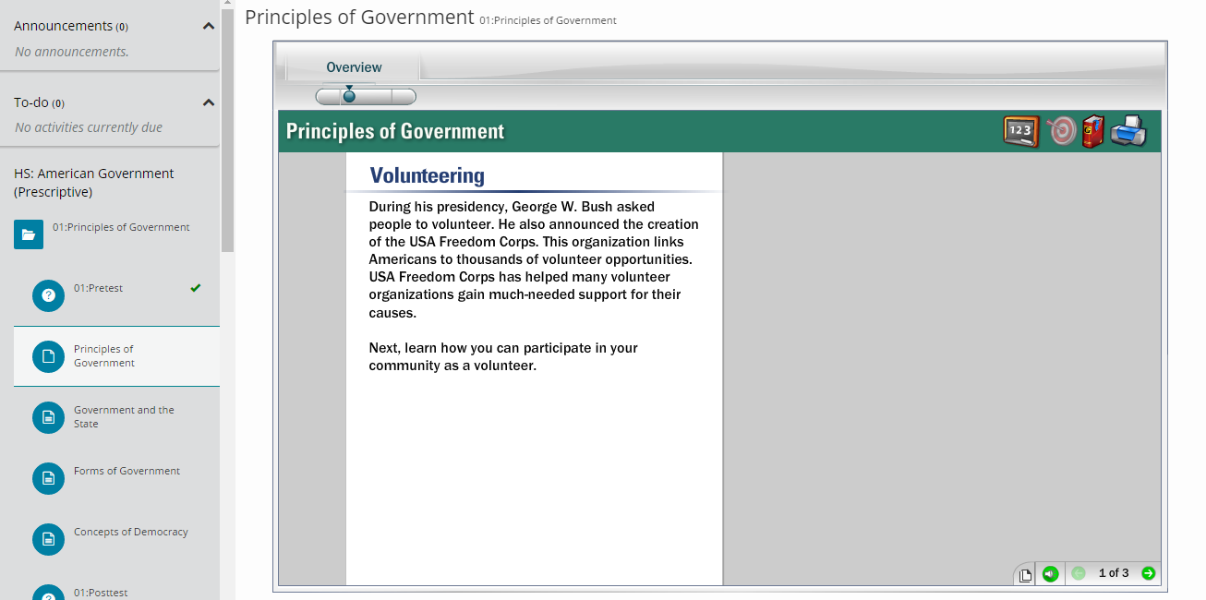
Assignments will have you submit in the bottom right corner. Once you complete something, you will get a check.
Use the arrows to navigate through a lesson.

Slide 8
Most activities will have a “Save and Close” option so you don’t lose your place.

Slide 9
You will get feedback on practice Questions.

Slide 10
For Discussions, Voice Activities, and Written Responses, use the drop box.

Slide 11
When You click “Show Drop Box” you can attach a file or type in a text box before you submit.
Make sure you SAVE and SUBMIT.

